Slide 1


CGB1221 DATABASE MANAGEMENT SYSTEMS PROJECT REVIEW
Department of Computer Science and Engineering
Academic Year: 2024 – 2025 (Even Semester)
Register Number : 2303811710421066
Name : JAYASURYA L
Year : II
Semester : IV
Section : B
Date : 03/06/2025
Guided By : Mr. P.MATHESWARAN.,M.E.,Ph.D.,

Slide 2
Title of the Project
CONTACT MANAGEMENT SYSTEM

Slide 3
Abstract
The Contact Management System offers secure login and registration, leading users to a dashboard for adding, editing, deleting, searching, and grouping contacts. All actions are processed by the backend, which interacts with the database to store and retrieve data. This modular architecture ensures efficient, reliable, and user-friendly contact management. Secure login and registration lead to a dashboard for managing contacts, with all operations processed by the backend and stored in the database for efficient and reliable access.

Slide 4
Introduction
The Contact Management System is designed with a modular architecture to ensure secure and efficient handling of contact information. Users access the system through a frontend interface with authentication for login and registration. Once authenticated, the dashboard enables users to add, edit, delete, search, and group contacts. All operations are managed by the backend, which interacts with the database for reliable data storage and retrieval.

Slide 5
DataBase Management - Concepts Used
Relational Database Model Tables Rows (Records) Columns (Fields/Attributes) Primary Keys Foreign Keys

Slide 6
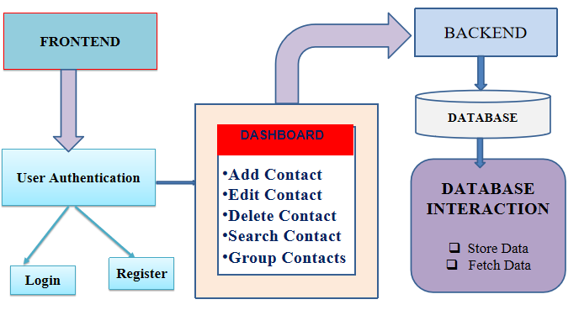
Proposed Architecture

Slide 7
Proposed Architecture - Description
User Authentication: Manages secure login and registration for users.
Login: Allows existing users to securely access their accounts.
Register: Enables new users to create an account.
Dashboard: Central hub where users manage all contact operations.
Backend: Processes user requests and applies business logic.
Database: Stores all user, contact, and group data securely.
Database Interaction: Handles storing and fetching data between backend and database.

Slide 8
List of Modules
User Authentication Module
Contact Management Module
Grouping Module
Search and Filter Module
Import/Export Module
Database Management Module

Slide 9
Module Description
User Authentication Module:
Handles secure login and registration, ensuring only authorized users access the system.
Contact Management Module:
Enables users to add, edit, and delete contact information efficiently.
Grouping Module:
Allows users to organize contacts into customizable groups for better management.

Slide 10
Module Description
Search and Filter Module:
Provides functionality to quickly search and filter contacts based on various criteria.
Import/Export Module:
Facilitates bulk importing and exporting of contacts for easy data transfer and backup.
Database Management Module:
Manages the storage, retrieval, and integrity of all contact and user data within the database.

Slide 11
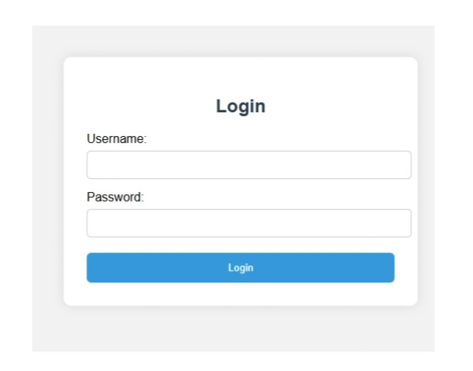
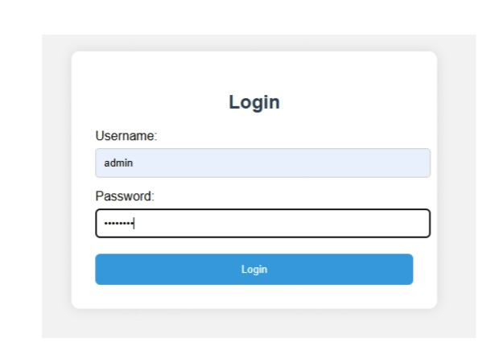
Results and Discussion
LOGIN PAGE

Slide 12
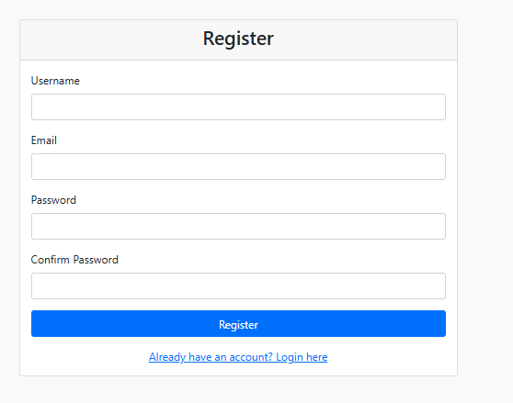
Results and Discussion (Cont...)
REGISTRATION

Slide 13
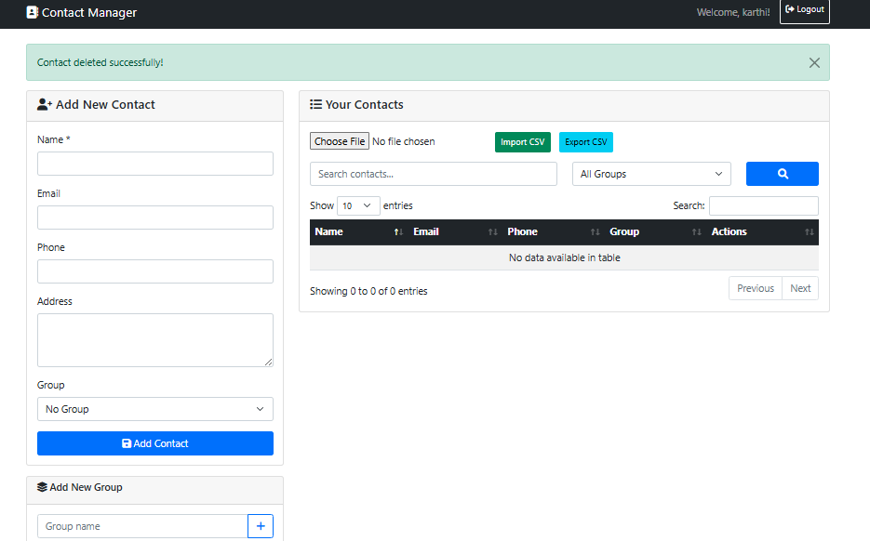
Results and Discussion (Cont...)
DASHBOARD

Slide 14
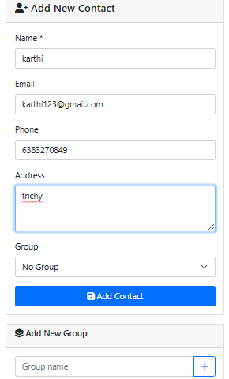
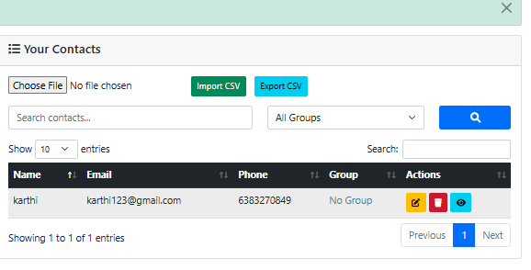
Results and Discussion (Cont...)
OPERATIONS

Slide 15
Conclusion
The proposed architecture ensures secure and efficient contact management through clear separation of frontend, backend, and database layers. User authentication safeguards access, while the dashboard streamlines all core contact operations. Robust database interaction guarantees reliable data storage and retrieval. Overall, the system is designed for user-friendliness, scalability, and data integrity.

Slide 16
Thank You
Any queries???

